Slide 1

Green Pace
Security Policy Presentation
Developer: Laura McAroy

Slide 2

OVERVIEW: DEFENSE IN DEPTH
This illustration provides a visual representation of the defense-in-depth best practice of layered security.

Slide 3
THREATS MATRIX
Likely STD-002-CPP STD-004-CPP STD-005-CPP STD-008-CPP STD-009-CPP STD-010-CPP | Priority STD-003-CPP STD-004-CPP STD-005-CPP STD-008-CPP STD-0010-CPP
Low priority STD-001-CPP STD-006-CPP STD-007-CPP | Unlikely STD-001-CPP STD-006-CPP

Slide 4
10 PRINCIPLES
Validate Input Data
STD-001-CPP
STD-002-CPP
Heed Complier Warnings
Architect and Design for Security Policies
STD-003-CPP
STD-004-CPP
STD-005-CPP
Keep It Simple
STD-010-CPP
Default Deny
Adhere to the Principle of Least Privilege
Sanitize Data Sent to Other Systems
Practice Defense in Depth
STD-008-CPP
Use Effective Quality Assurance Techniques
STD-006-CPP
Adopt a Secure Coding Standard
STD-007-CPP
STD-009-CPP

Slide 5
CODING STANDARDS
STD-004-CPP – Do not store an already-owned pointer value in an unrelated smart pointer
STD-005-CPP – Detect and handle memory allocation errors
STD-008-CPP – Do not access freed memory
STD-010-CPP – Guarantee that library functions do not overflow
STD-003-CPP – Do not attempt to create a std::string from a null pointer
STD-002-CPP – Value-returning functions must return a value from all exit paths
STD-009-CPP – Guarantee exception safety
STD-007-CPP – Handle all exceptions
STD-001-CPP – Do Not Cast to an out-of-range enumeration value
STD-006-CPP – Use a static assertion to test the value of a constant expression

Slide 6
ENCRYPTION POLICIES
Encryption at Rest
The process of translating saved data to another form of data via encryption
Encryption at Flight
The process of encrypting data that is moving over a network
Encryption in Use
Data is never left unsecured regardless of its lifecycle stage

Slide 7
TRIPLE-A POLICIES
Authentication
Process of verifying credentials before users can gain access to a system
Authorization
Levels of access are determined for system users
Accounting
System users are monitored and logged according to user interaction

Slide 8
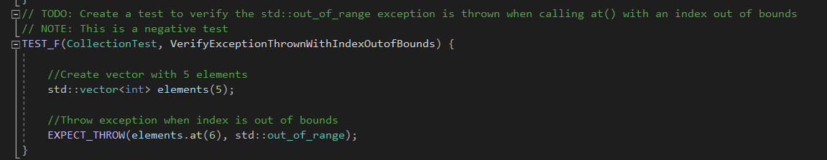
Unit Testing
Unit Test to ensure that exception is thrown when index is out of bounds

Slide 9
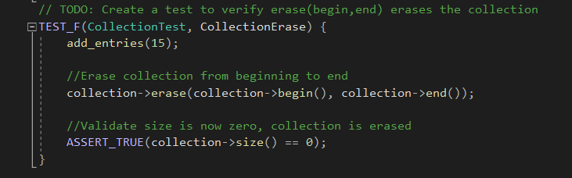
Unit Testing
Unit Test to ensure that entire collection is erased

Slide 10
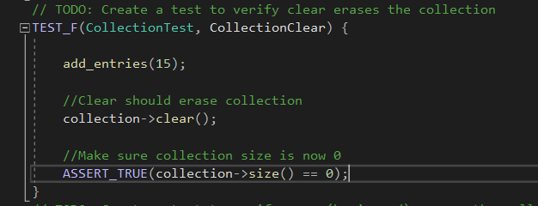
Unit Testing
Second Unit test to ensure collection is erased

Slide 11
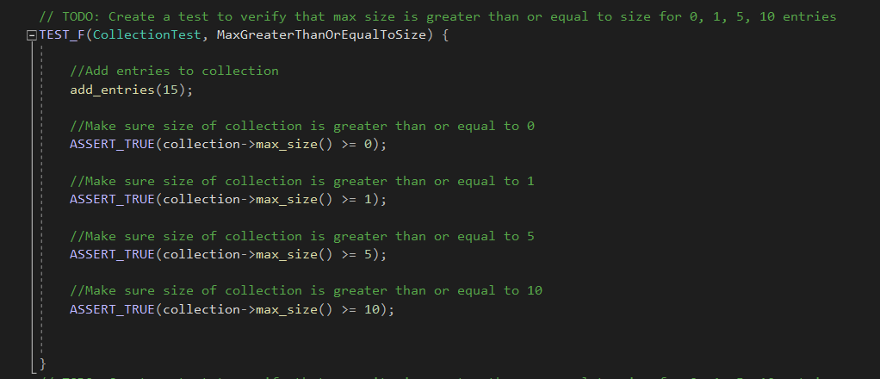
Unit Testing
Unit testing to ensure size of collection

Slide 12

AUTOMATION SUMMARY

Slide 13
TOOLS
DevSecOps, Development, Security, and Operations, is the new recommended guideline for development since it incorporates security measures throughout the SDLC
Several tools are used throughout the process to promote system security
SD Elements – automates security requirements based on technology in use and business requirements
IriusRisk – threat model platform that can be used throughout entire SDLC
Parasoft Tool Suite – static analysis and automated software testing
Chef InSpec – detects security violations and provides a report of findings
Splunk – log management tool
Tripwire – monitoring tool to ensure configuartions remain in known and trusted states

Slide 14
RISKS AND BENEFITS
Don’t leave security till the end
Adopting a secure coding standard in the beginning :
Keeps security a priority from the beginning phases
Minimizes time and cost spent correcting vulnerabilities found later
Increases speed and efficiency in development process
Risks include:
Shift in mindset to security focused
Ensuring sufficient knowledge in security policies and procedures
Steps to be taken:
Educate and train current employees on security poiicies and standards
Implement tools to help enhance security on existing projects

Slide 15
RECOMMENDATIONS
Assess current policies and compare them to current standards and best practices
Prioritize gaps identified during assessment
Develop a plan and process to correct issues
Educate and train staff on current best practices
Utilize automated testing and monitoring tools
Monitor and enforce new policies
Audits
Reviews
Reports

Slide 16
CONCLUSIONS
Ensure company policies match current best practices
Adopt a secure coding standard
Implement a Defense in Depth approach
Include automated testing
Ensure staff is trained in security implementation
Communicate policy changes
Determine which security tools work best with your system

Slide 17
REFERENCES
Ballman, A. (n.d.). Rules - SEI CERT C++ Coding Standard - Confluence. Wiki.sei.cmu.edu; Carnegie Mellon University. Retrieved February 25, 2024, from https://wiki.sei.cmu.edu/confluence/display/cplusplus/2+Rules
Ballman, A. (2016). SEI CERT C++ Coding Standard Rules for Developing Safe, Reliable, and Secure Systems in C++ 2016 Edition. https://resources.sei.cmu.edu/downloads/secure-coding/assets/sei-cert-cpp-coding-standard-2016- v01.pdf
Gill, N. (2023, May 16). A Guide to DevSecOps Tools and Continuous Security For an Enterprise. Www.xenonstack.com. https://www.xenonstack.com/blog/devsecops-tools

